Slide 1
Proof of Theorem 3.2
Reduction: Steiner Tree → Metric Steiner Tree
Vazirani — Approximation Algorithms, Chapter 3
Example: V = {a, b, c, d}, R = {a, c, d} (Required), Steiner = {b}
Edges: a-b(3), b-c(2), b-d(4), a-c(7), c-d(8)

Slide 2
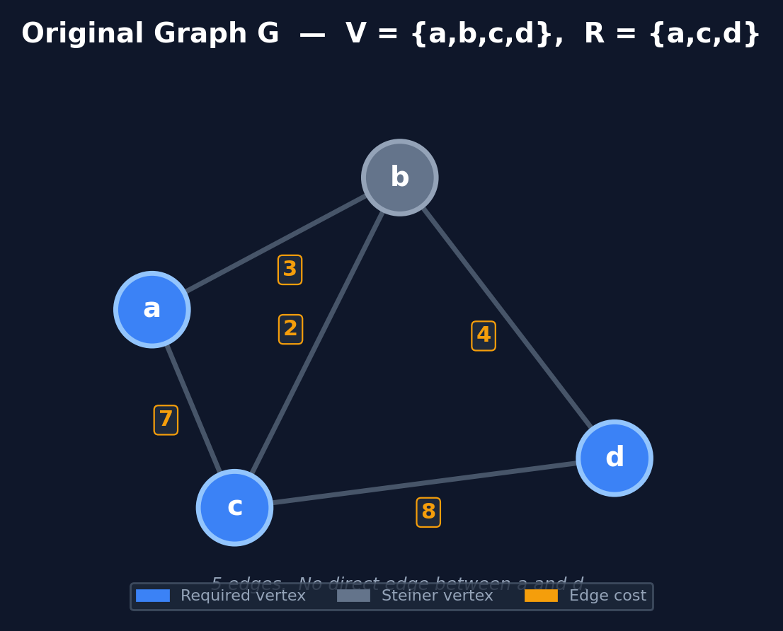
Slide 1 / 7 — Instance I: Graph G = (V, E)
V = {a, b, c, d} Required R = {a, c, d} Steiner = {b}

Slide 3
Slide 2 / 7 — Construction: Shortest Path for Every Pair
Let G' be the complete graph on V. cost'(u,v) = shortest u-v path in G.
Pair (a, b)
Pair (a, c)
Pair (a, d)
• Direct a-b: 3
• Via c: 7+2 = 9
• Direct a-c: 7
• Via b: 3+2 = 5
• No direct edge
• Via b: 3+4 = 7
⟹ cost'(a,b) = 3
⟹ cost'(a,c) = 5 ⭐
⟹ cost'(a,d) = 7 (new!)
Pair (b, c)
Pair (b, d)
Pair (c, d)
• Direct b-c: 2
• Via a: 3+7 = 10
• Direct b-d: 4
• Via c: 2+8 = 10
• Direct c-d: 8
• Via b: 2+4 = 6
⟹ cost'(b,c) = 2
⟹ cost'(b,d) = 4
⟹ cost'(c,d) = 6 ⭐

Slide 4
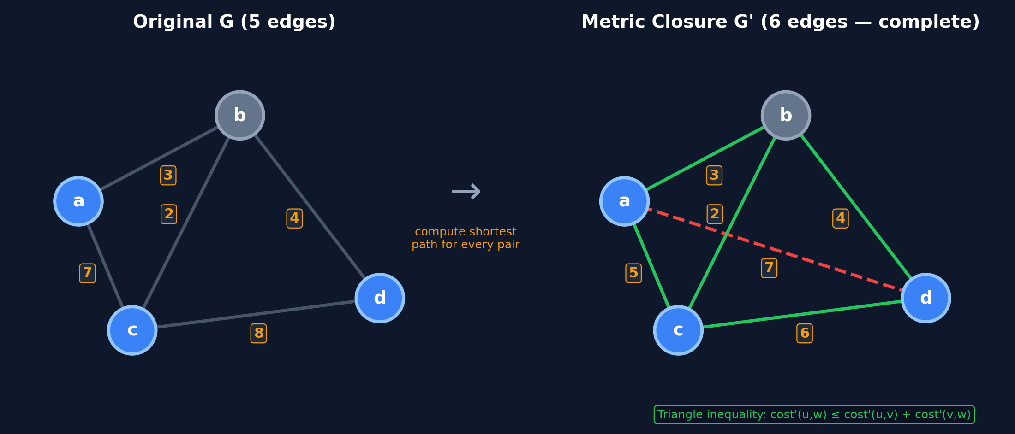
Slide 3 / 7 — Metric Closure G' (Complete Graph)
G' has C(4,2)=6 edges. cost'(u,v)=dist_G(u,v). R'=R={a,c,d}.

Slide 5
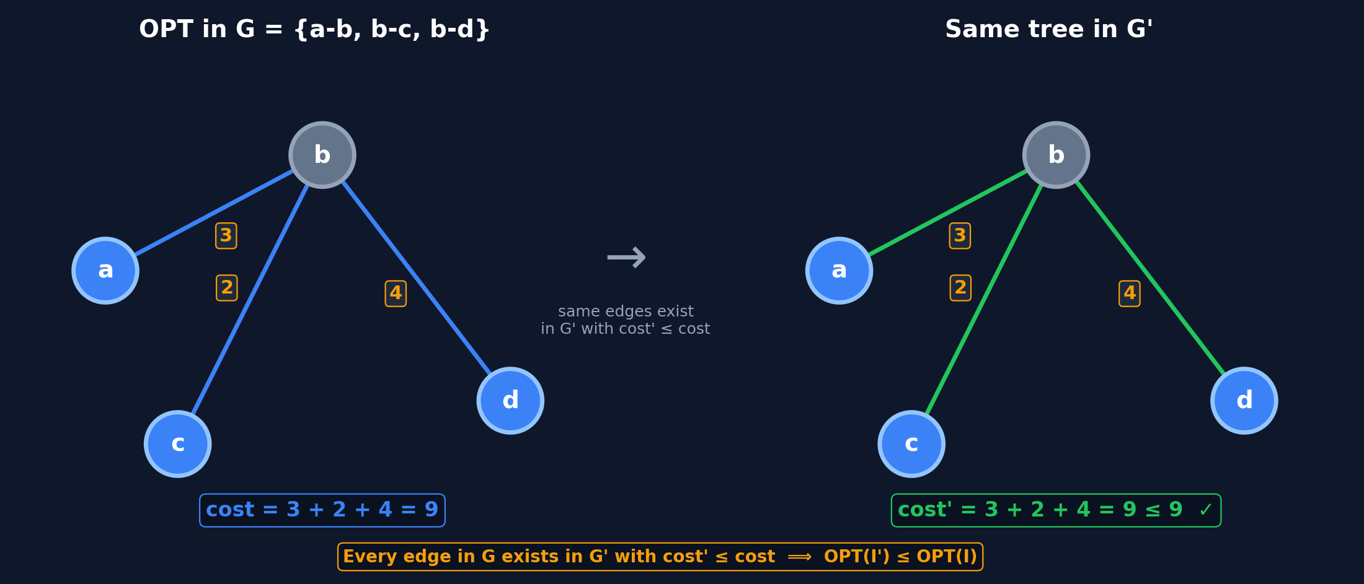
Slide 4 / 7 — Direction 1: OPT(I') ≤ OPT(I)
For any edge (u,v) ∈ E, cost in G' ≤ cost in G ⟹ OPT(I') ≤ OPT(I).

Slide 6
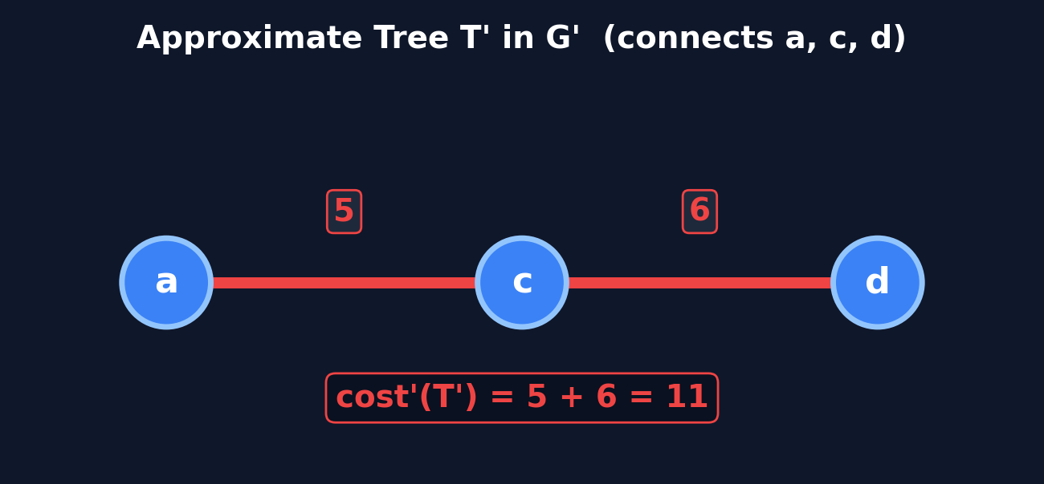
Slide 5 / 7 — Direction 2, Step A: Approx Tree T' in G'
Suppose an α-approximation gives T' = {a-c, c-d} in G'.
cost'(T') = 5 + 6 = 11 (connects all required vertices a, c, d)

Slide 7
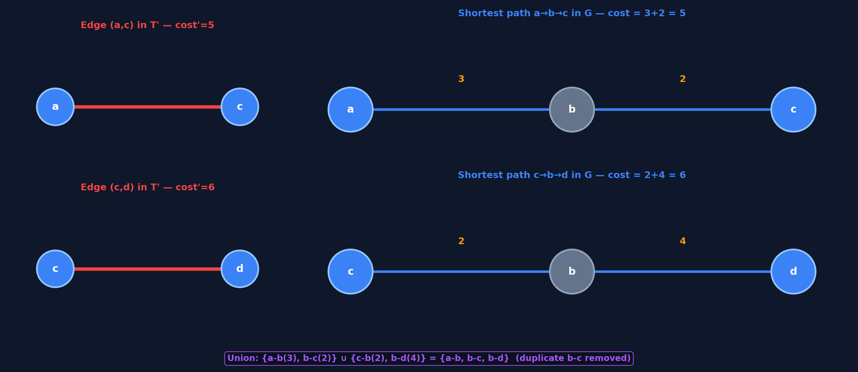
Slide 6 / 7 — Step B: Replace Edges by Shortest Paths
Replace each edge of T' by its corresponding shortest path in G:

Slide 8
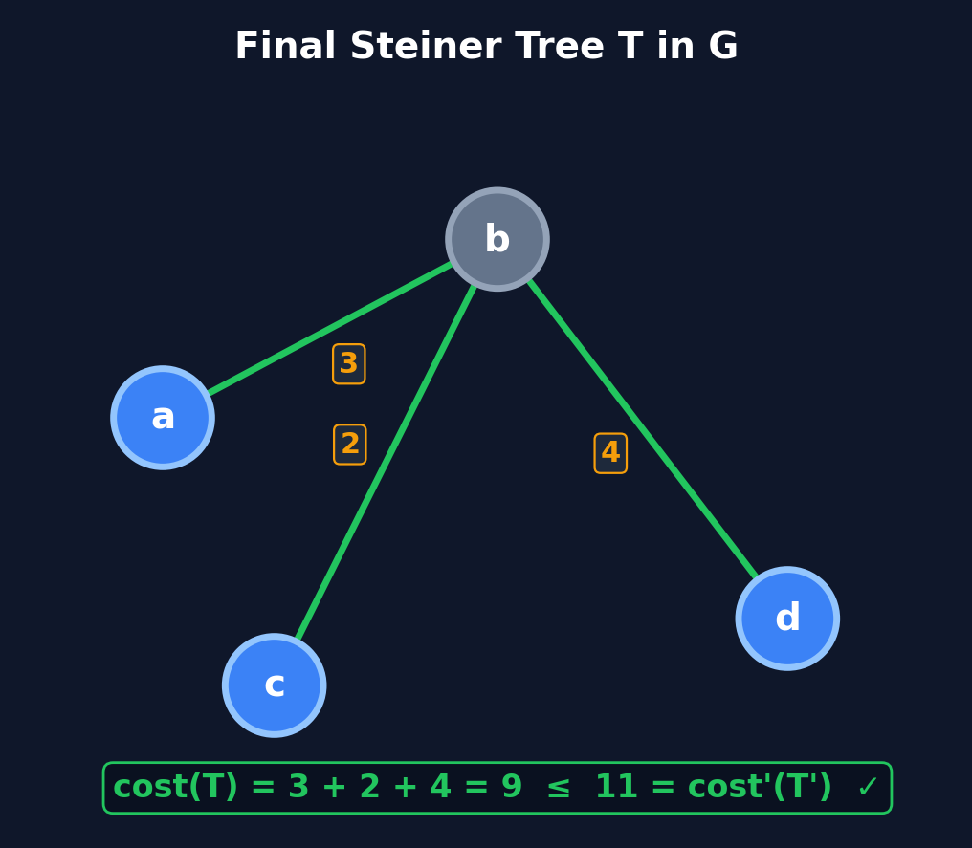
Slide 7 / 7 — Step C: Final Steiner Tree T in G
After removing duplicates, the subgraph is already a tree.
T = {a-b(3), b-c(2), b-d(4)} cost(T) = 3 + 2 + 4 = 9 ≤ 11 = cost'(T') ✓

Slide 9
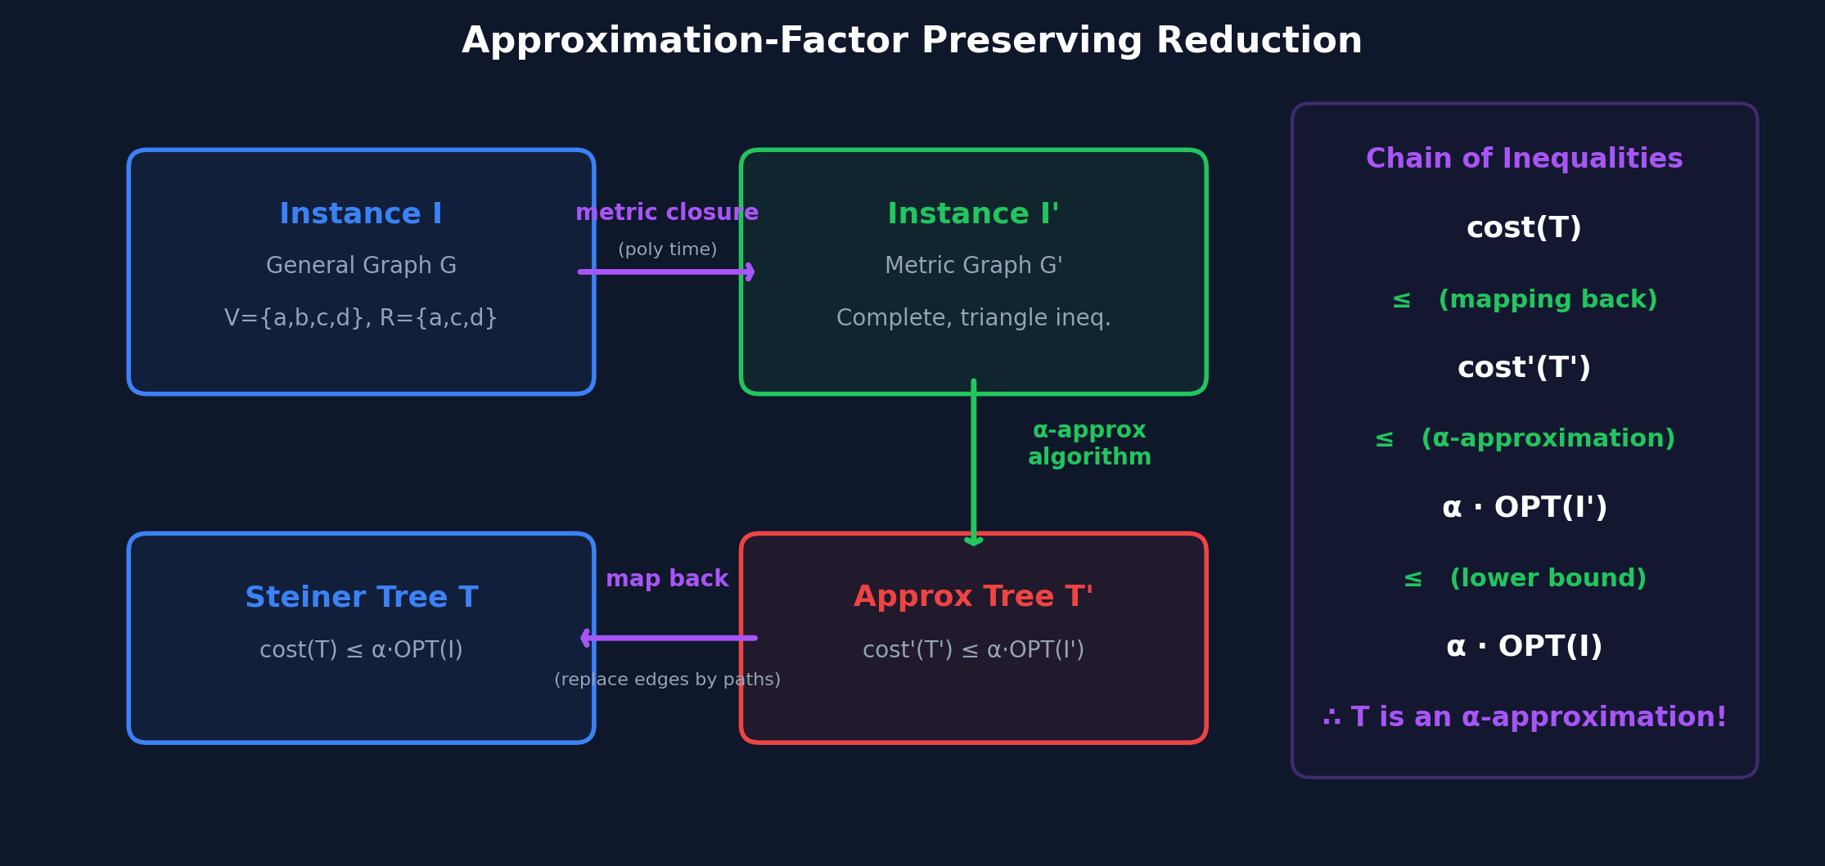
Conclusion — Factor-Preserving Reduction

Slide 10
Theorem 3.2 — Numerical Verification
Numerical Verification
OPT(I) in G:
tree {a-b(3), b-c(2), b-d(4)}, cost = 9
OPT(I') in G':
same tree with cost' = 9 ≤ 9 ✓
Approx T' in G':
{a-c(5), c-d(6)}, cost' = 11
Map back T in G:
{a-b, b-c, b-d}, cost = 9 ≤ 11 ✓
Theorem 3.2
The reduction from the Steiner tree problem
to the metric Steiner tree problem is
approximation factor preserving.
Chain of Inequalities:
cost(T)
≤ cost'(T') (mapping back)
≤ α · OPT(I') (α-approximation)
≤ α · OPT(I) (lower bound)
∴ T is an α-approximation for I
9 ≤ 11 ≤ α · 9 ≤ α · 9
"Any approximation factor for the metric Steiner tree carries over to the general Steiner tree."
■

